Slide 1
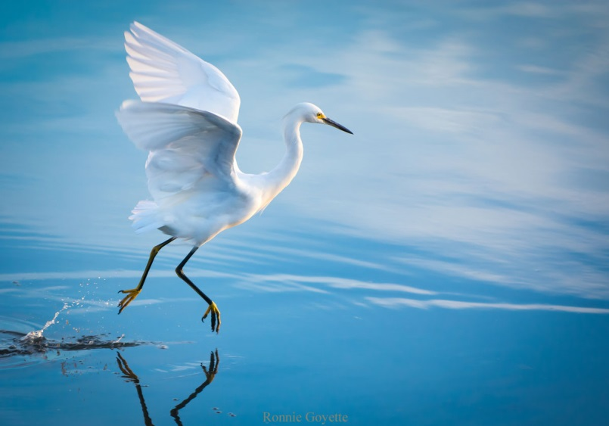
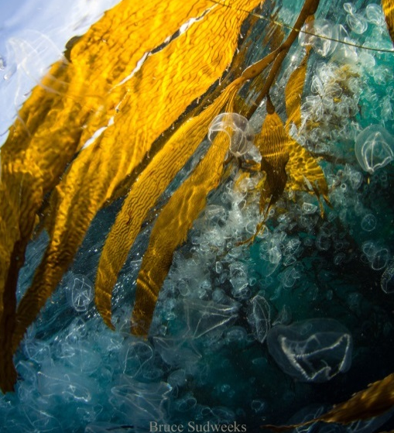
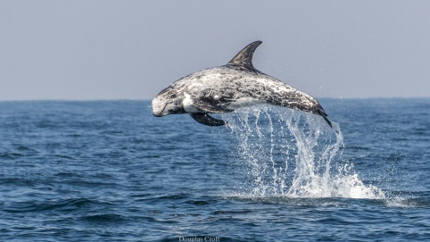
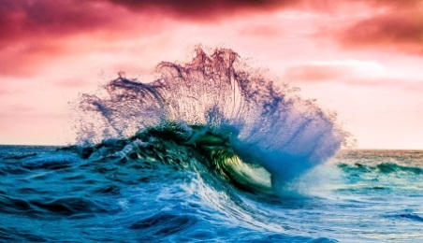
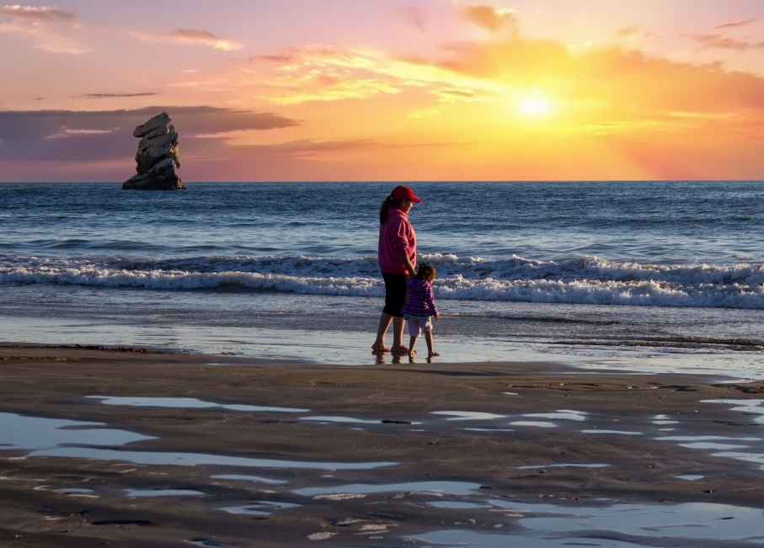

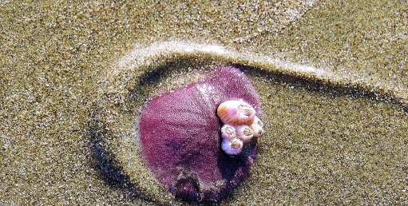
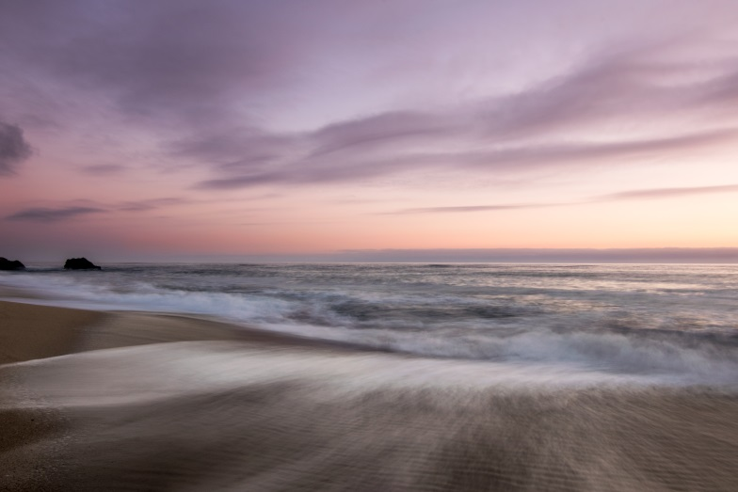
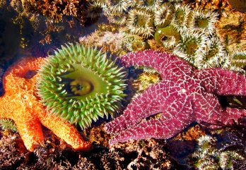
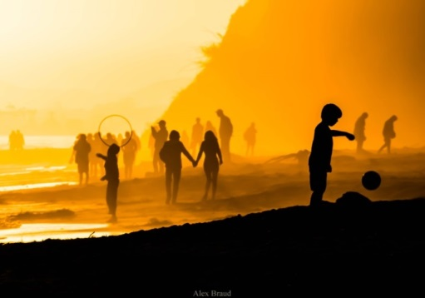
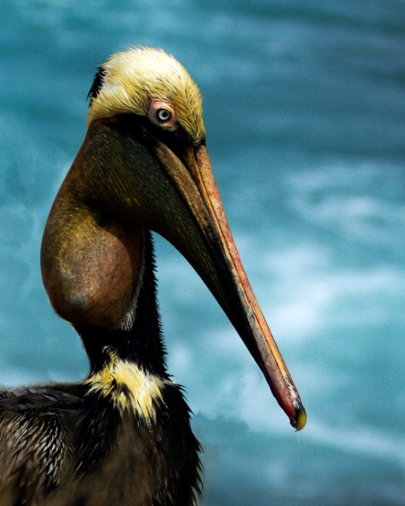
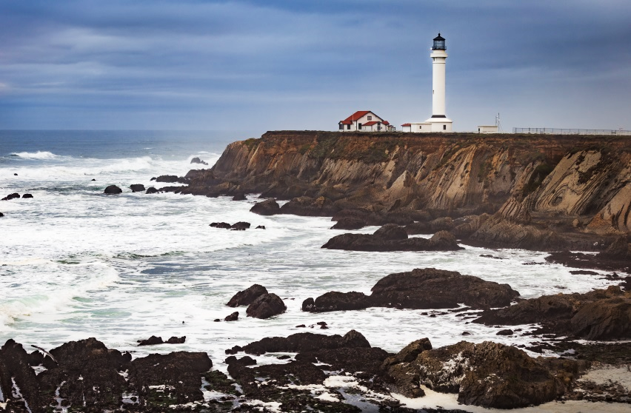
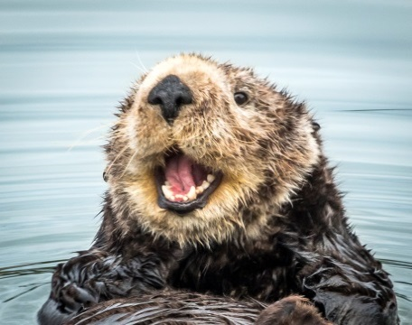
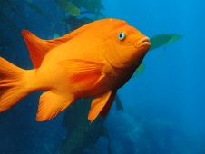
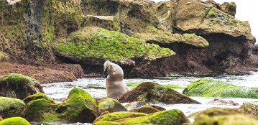
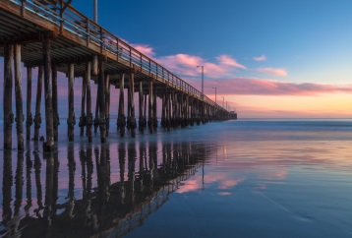
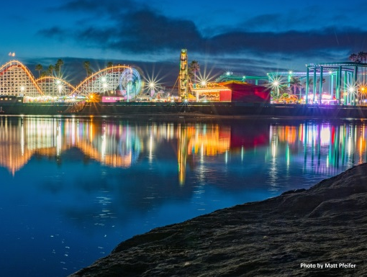
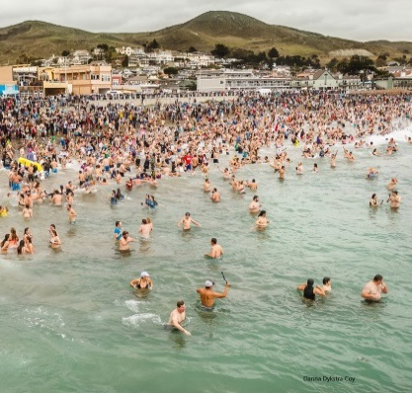
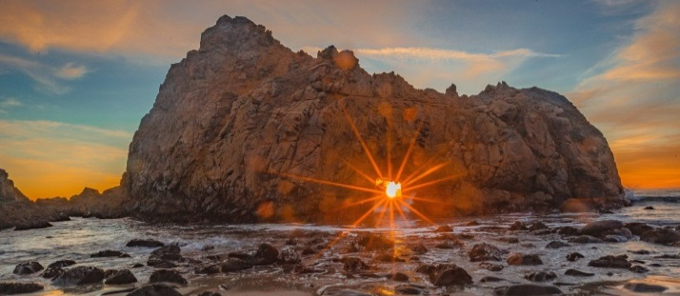
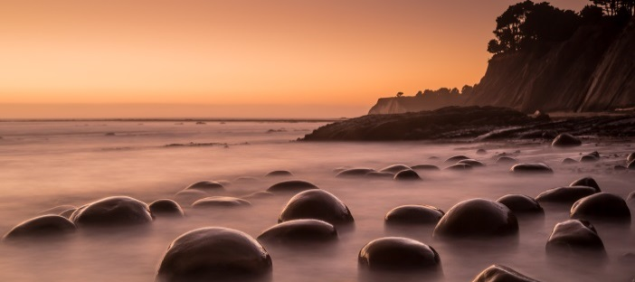
Douglass Croft
Robert Smith
STATEWIDE REPORT
Linda Dron
Carol Chihara
Jason Husby
Hollister Ranch Access Program Informational Report
Ariel Bauman
December 14, 2018 Item F 5
Maria Lippert
David Freeman
Josheph Fronteras
Alex Braud
Arnold Silverman
Bill Lapworth
Douglass Croft
Pankaj Bhargava
Al Russell

Slide 2
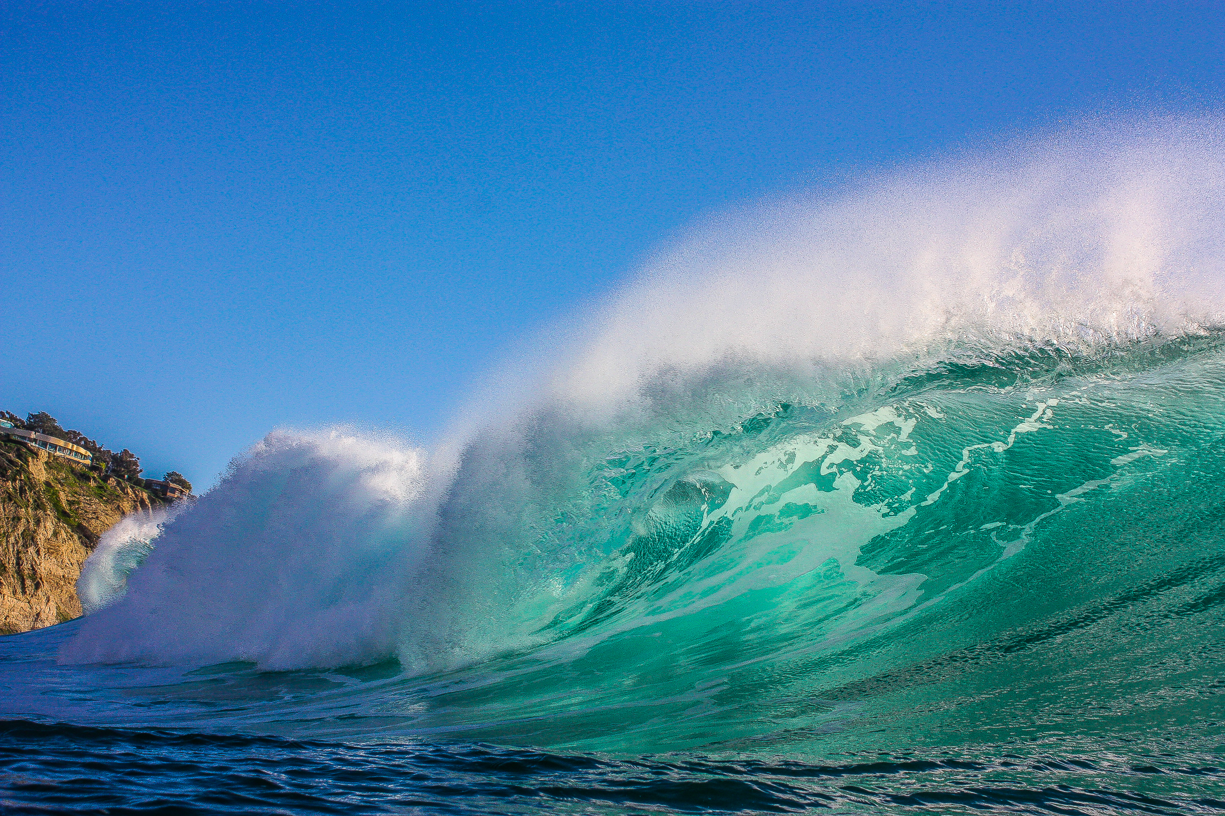
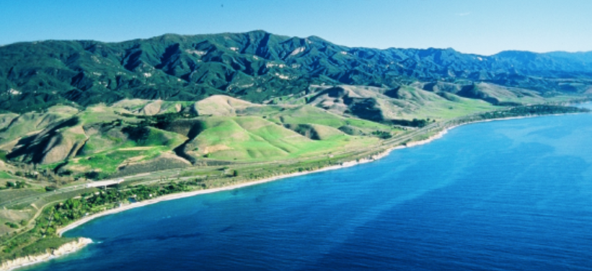

Hollister Ranch, Santa Barbara County
14,000 Acres - 8.5 Miles Of Coastline
California Coastal Commission
Statewide report– item F 5
Slide 2

Slide 3
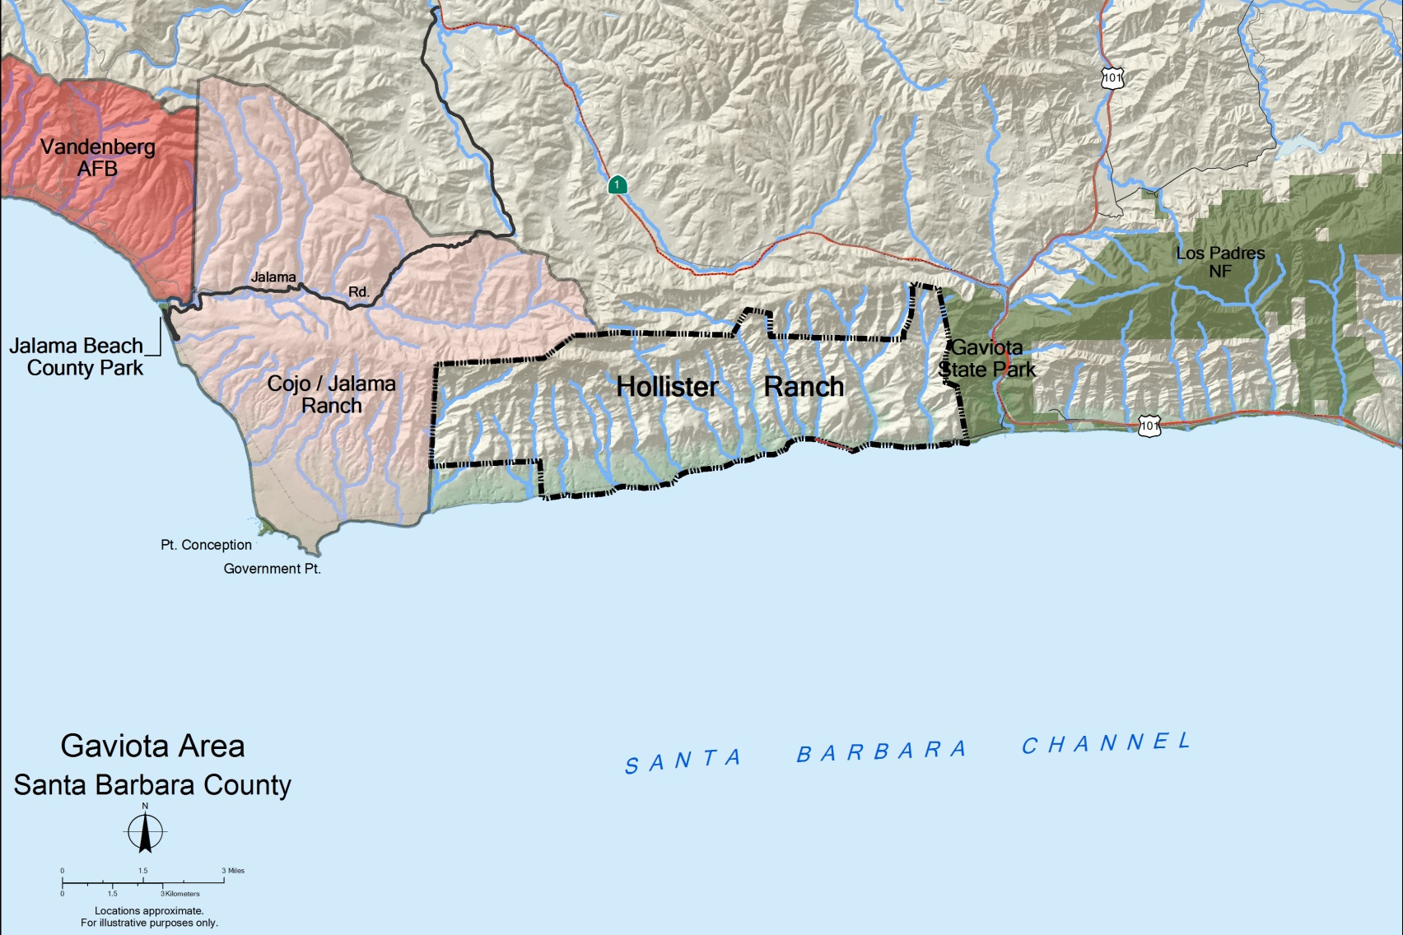
GAVIOTA AREA OF SANTA BARBARA COUNTY
California Coastal Commission
Statewide report– item F 5
Slide 3

Slide 4
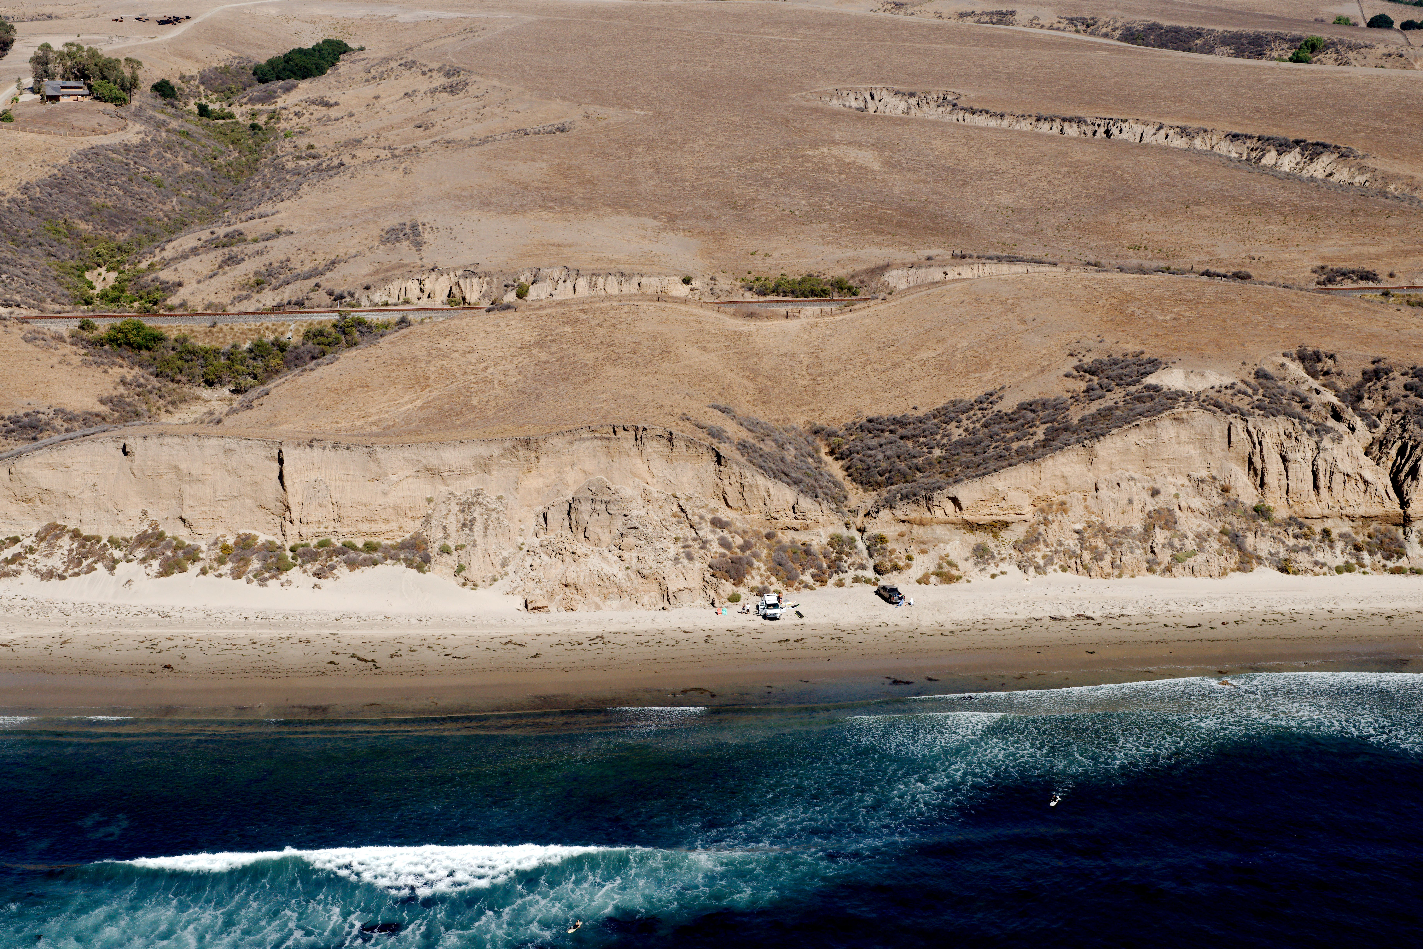
Private recreational use at Hollister Ranch
CCRP # 201307618
California Coastal Commission
Statewide report– item F 5
Copyright (C) 2002-2018 Kenneth & Gabrielle Adelman, California Coastal Records Project, www.Californiacoastline.org
Slide 4

Slide 5
AB 643 (Calvo, 1979) PRC Sec. 30610.3
Authorized Commission to:
  Designate areas of inadequate access
  Prepare and adopt an Access Program
Authorized Conservancy to:
  Conduct Surveys
  Acquire property
  Set in-lieu fees
  Implement and manage access plan
California Coastal Commission
Statewide report– item F 5
Slide 5

Slide 6
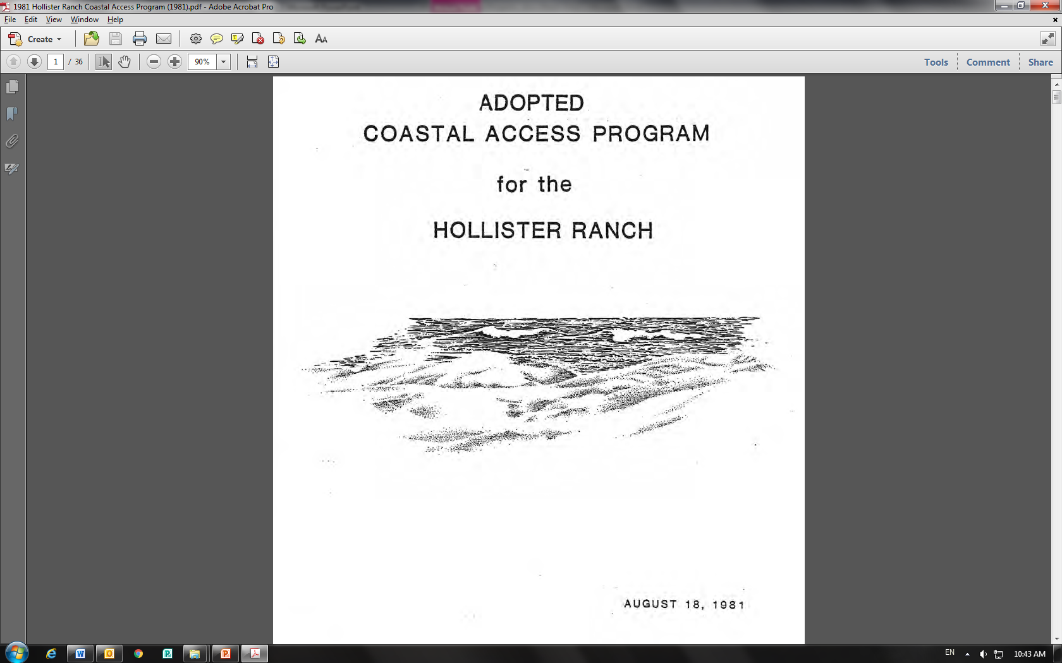
Adopted in 1981
Revised in 1982
California Coastal Commission
Statewide report– item F 5
Slide 6

Slide 7
AB 321 (Hanningan, 1982) PRC Sec. 30610.8
Applied specifically to Hollister Ranch
  Intended to provide access “as expeditiously as possible”
  Established Hollister in-lieu fee at $5,000
  Directed $500,000 to begin program implementation
  Invoked the acquisition authority of the Public Works Board
California Coastal Commission
Statewide report– item F 5
Slide 7

Slide 8
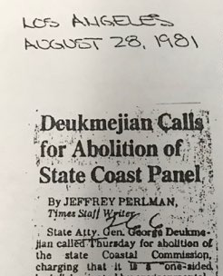
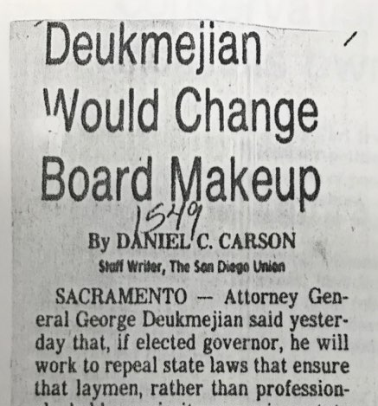
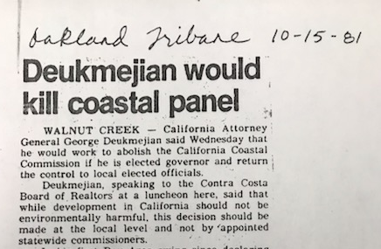
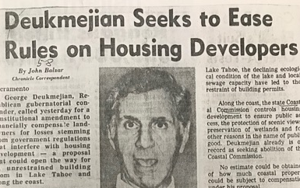
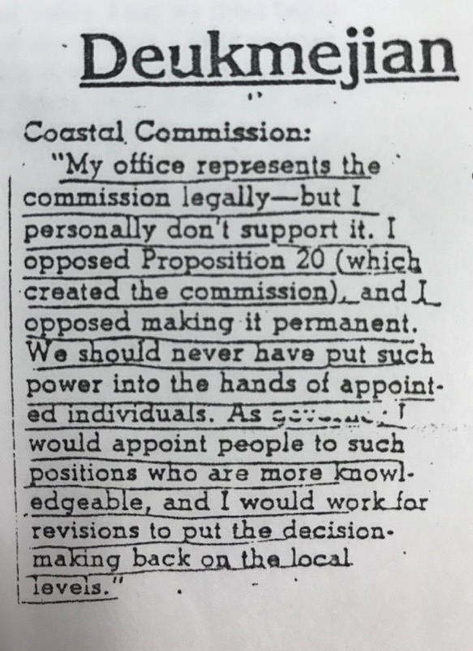
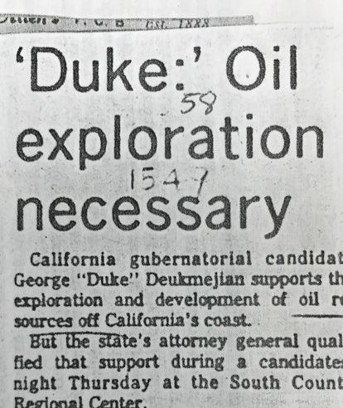
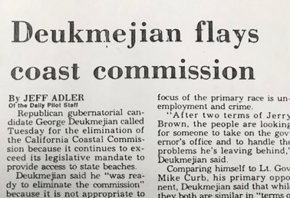
California Coastal Commission
Statewide report– item F 5
Slide 8

Slide 9
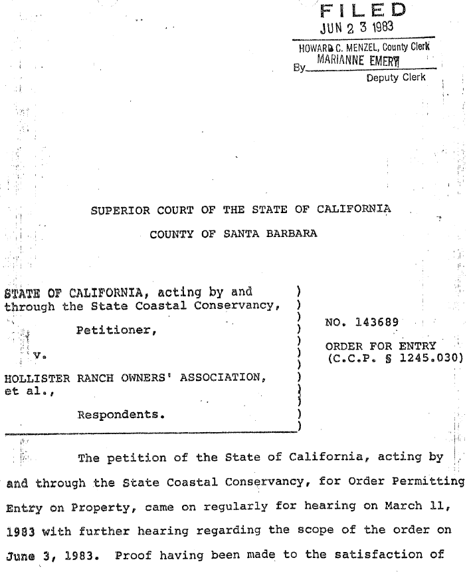
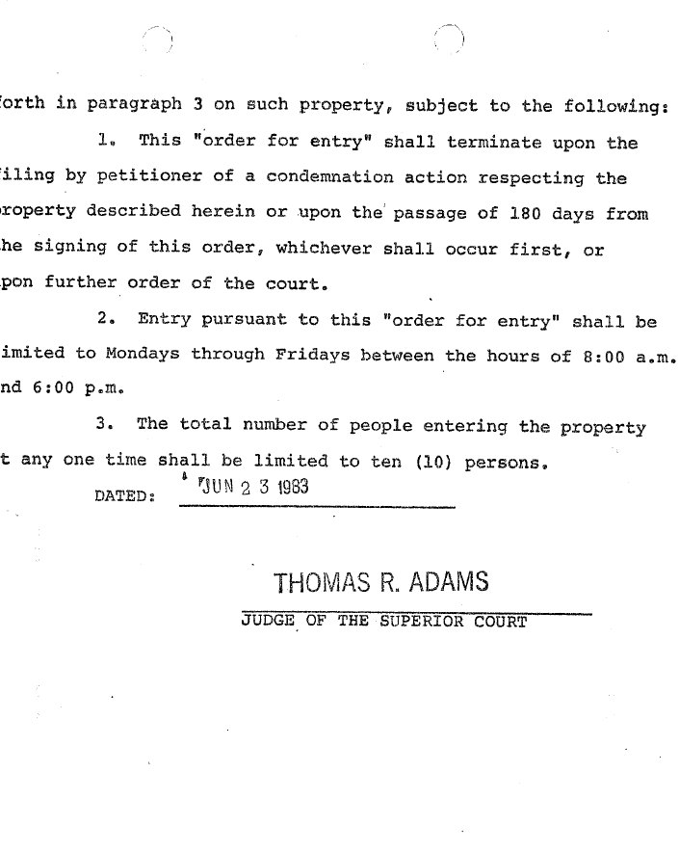
California Coastal Commission
Statewide report– item F 5
Slide 9
Notes:
Add signature block at the end of doc and highlight the signature

Slide 10
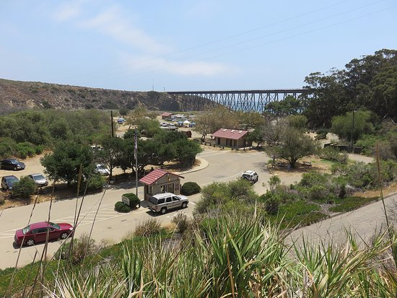
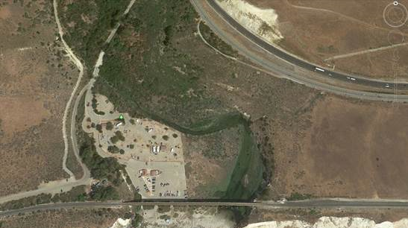

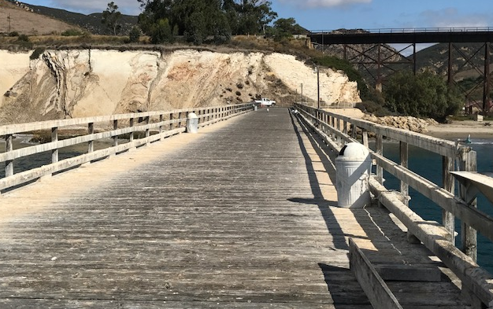
Gaviota State Park
Beach
Camping
Day-use Parking Lot
Public Pier and Hoist
California Coastal Commission
Statewide report– item F 5
Slide 10

Slide 11

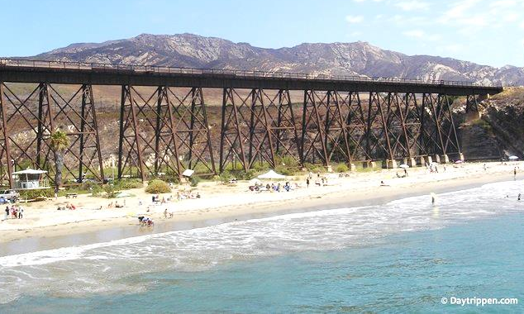
Gaviota State Park
Popular for beach activities
California Coastal Commission
Statewide report– item F 5
Slide 11

Slide 12
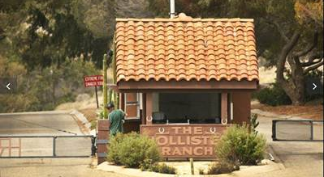
Hollister Ranch
Private Entrance - Security Gate
Photo credit: Los Angeles Times 11.19.18
California Coastal Commission
Statewide report– item F 5
Slide 12

Slide 13
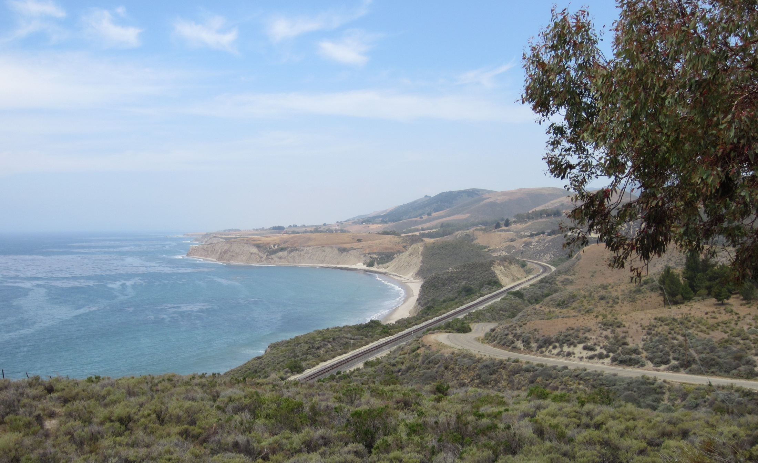
(
HROA private access road - Rancho Real
California Coastal Commission
Photo credit: Los Angeles Times 11.19.18
Statewide report– item F 5
Slide 13

Slide 14
California Coastal Commission
Statewide report– item F 5
Slide 14

Slide 15

1982 Program – Shuttle Van
  Controlled and monitored public access
  Vans staged from Gaviota State Park
  Vans (15 person) to provide access using Rancho Real Road to existing beach roads
California Coastal Commission
Statewide report– item F 5
Slide 15

Slide 16

1982 Program – Pedestrian Trail
  Provides for a continuous pedestrian trail using easements along shoreline & Rancho Real Rd.
  Trail to utilize Rancho Real Rd. when lateral shoreline passage not possible
  Trail will connect from Rancho Real Road to existing (vertical) beach access road crossings to reach the shoreline
California Coastal Commission
Statewide report– item F 5
Slide 16

Slide 17

1982 Program – Bicycle Trail
  Will utilize Rancho Real Rd. and existing cross roads to reach beaches
  Trail will be a Class III bike path (shared use with vehicular traffic)
California Coastal Commission
Statewide report– item F 5
Slide 17

Slide 18

1982 Program – Beach Facilities
  Program identifies needed beach facilities:
  Restrooms
  Drinking water
  Showers
  Trash containers
  Signage (rules)
  Security guards
  Shuttle turn around areas
California Coastal Commission
Statewide report– item F 5
Slide 18

Slide 19
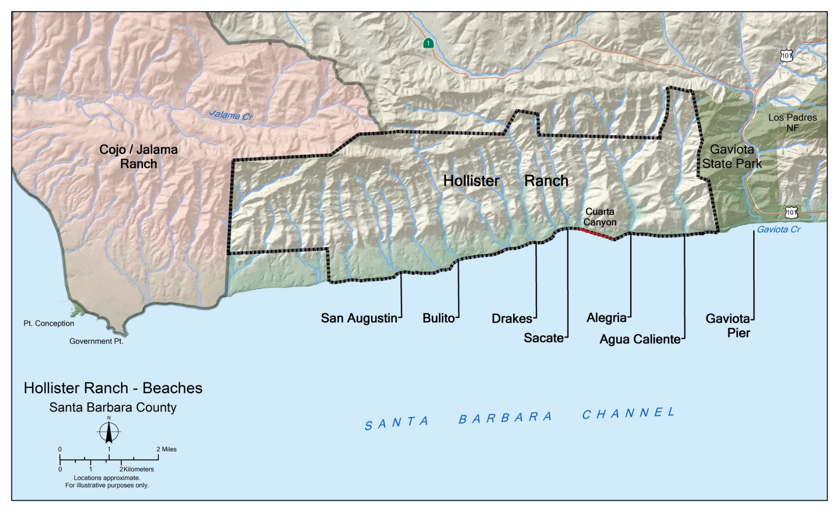
Phase I
Phase II
Phase III
California Coastal Commission
Statewide report– item F 5
Slide 19

Slide 20
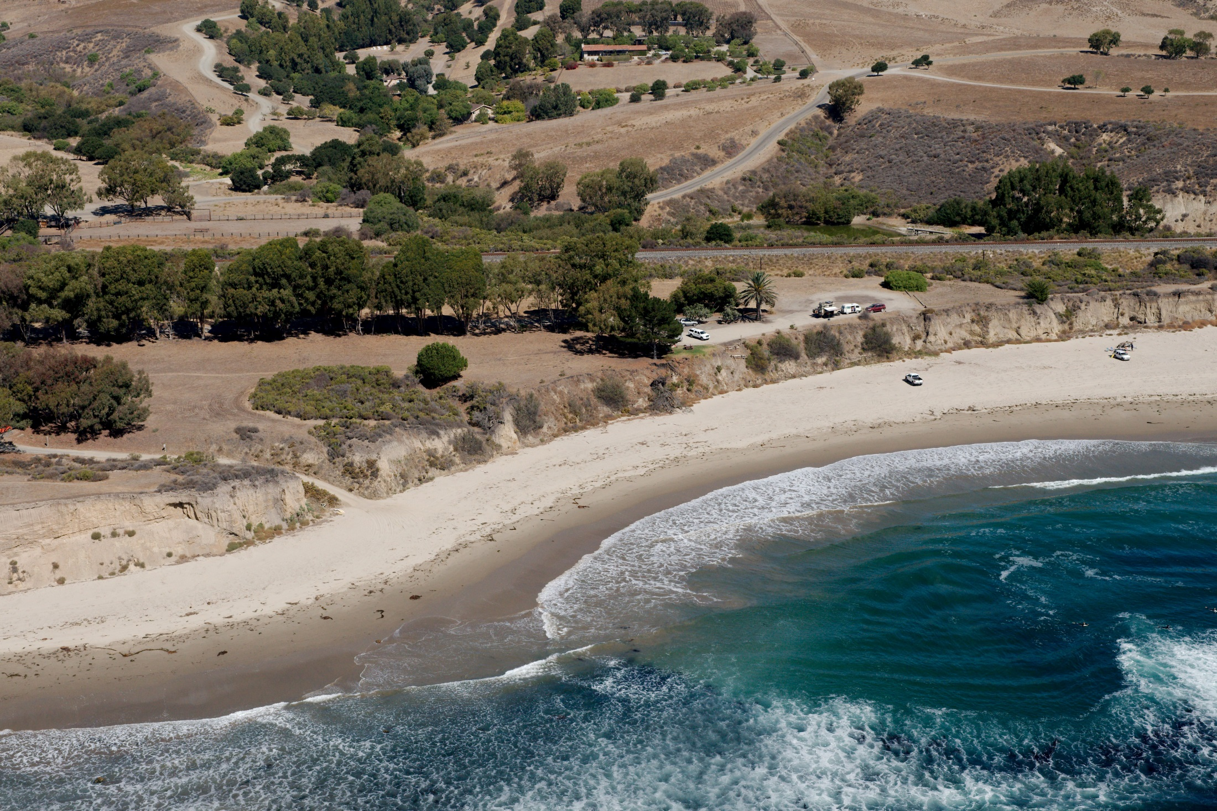
Copyright (C) 2002-2018 Kenneth & Gabrielle Adelman, California Coastal Records Project, www.Californiacoastline.org
San Augustin Beach
CCRP # 201307632
California Coastal Commission
Statewide report– item F 5
Slide 20

Slide 21
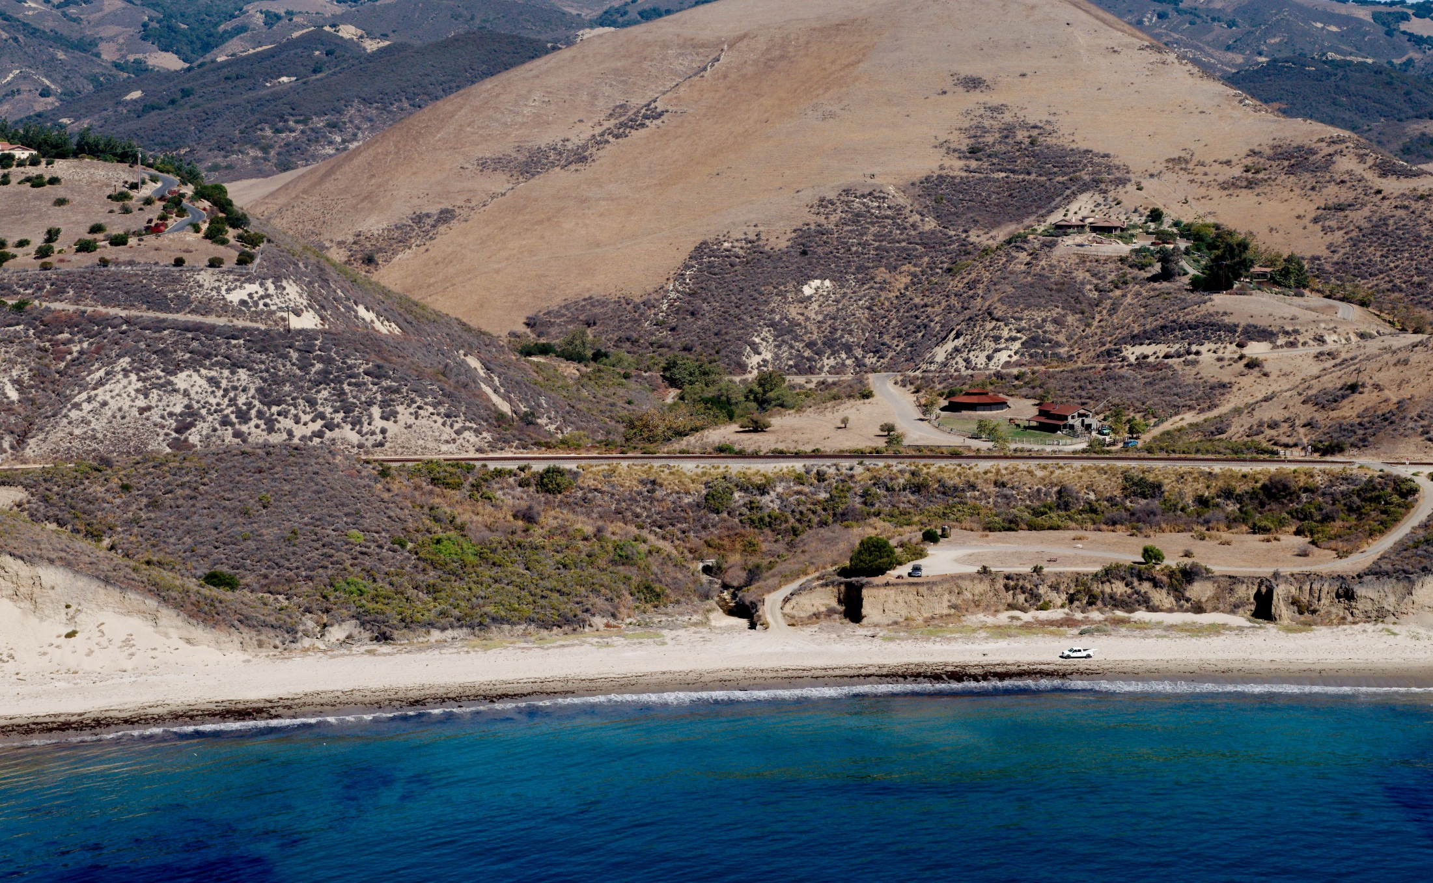
Sacate Beach
Includes Cuarta Canyon Beach/YMCA parcel
CCRP# 201307691
California Coastal Commission
Statewide report– item F 5
Copyright (C) 2002-2018 Kenneth & Gabrielle Adelman, California Coastal Records Project, www.Californiacoastline.org
Slide 21

Slide 22
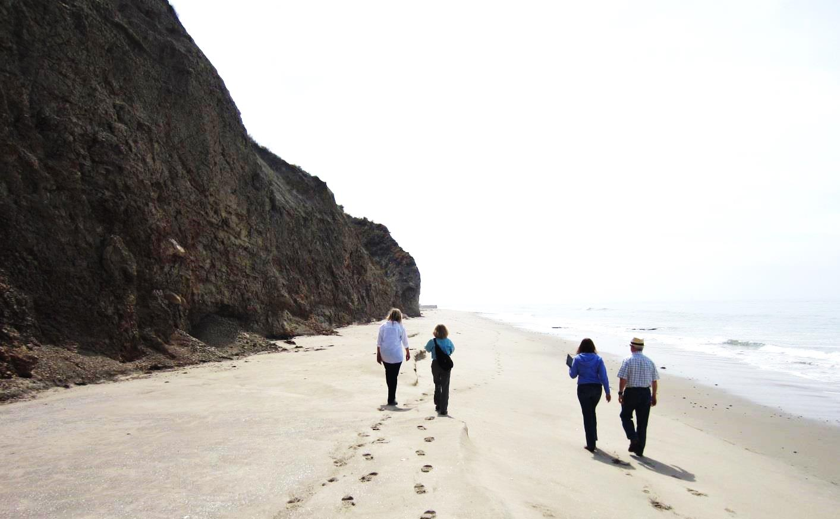
East End of Sacate Beach-
Cuarta Canyon Beach
California Coastal Commission
Statewide report– item F 5
Slide 22

Slide 23
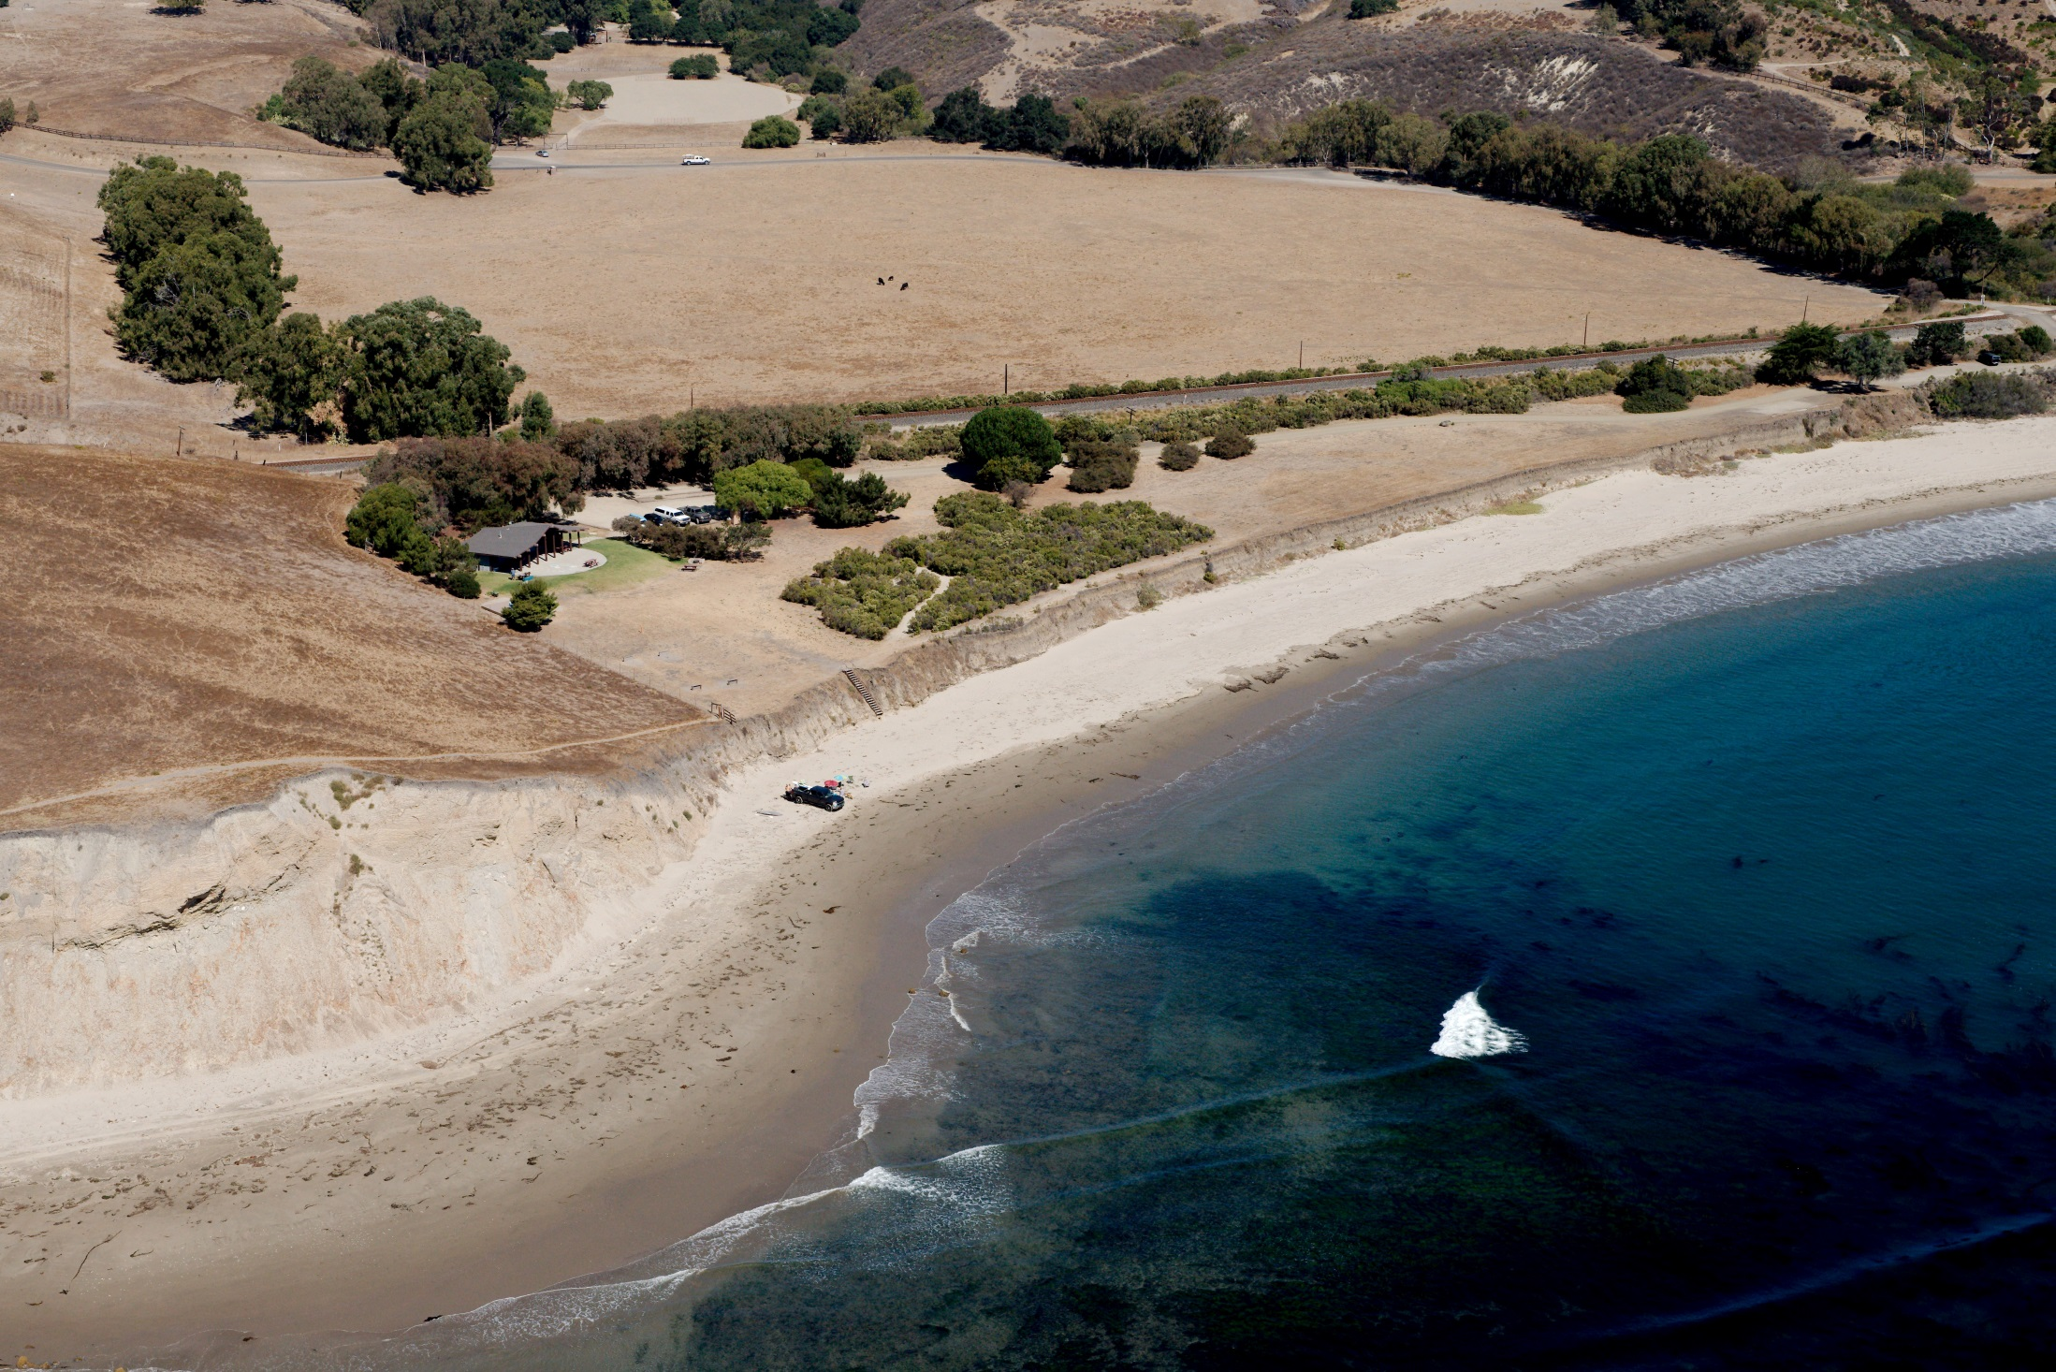
Copyright (C) 2002-2018 Kenneth & Gabrielle Adelman, California Coastal Records Project, www.Californiacoastline.org
Bulito Beach
CCRP # 201307652
California Coastal Commission
Statewide report– item F 5
Slide 23

Slide 24
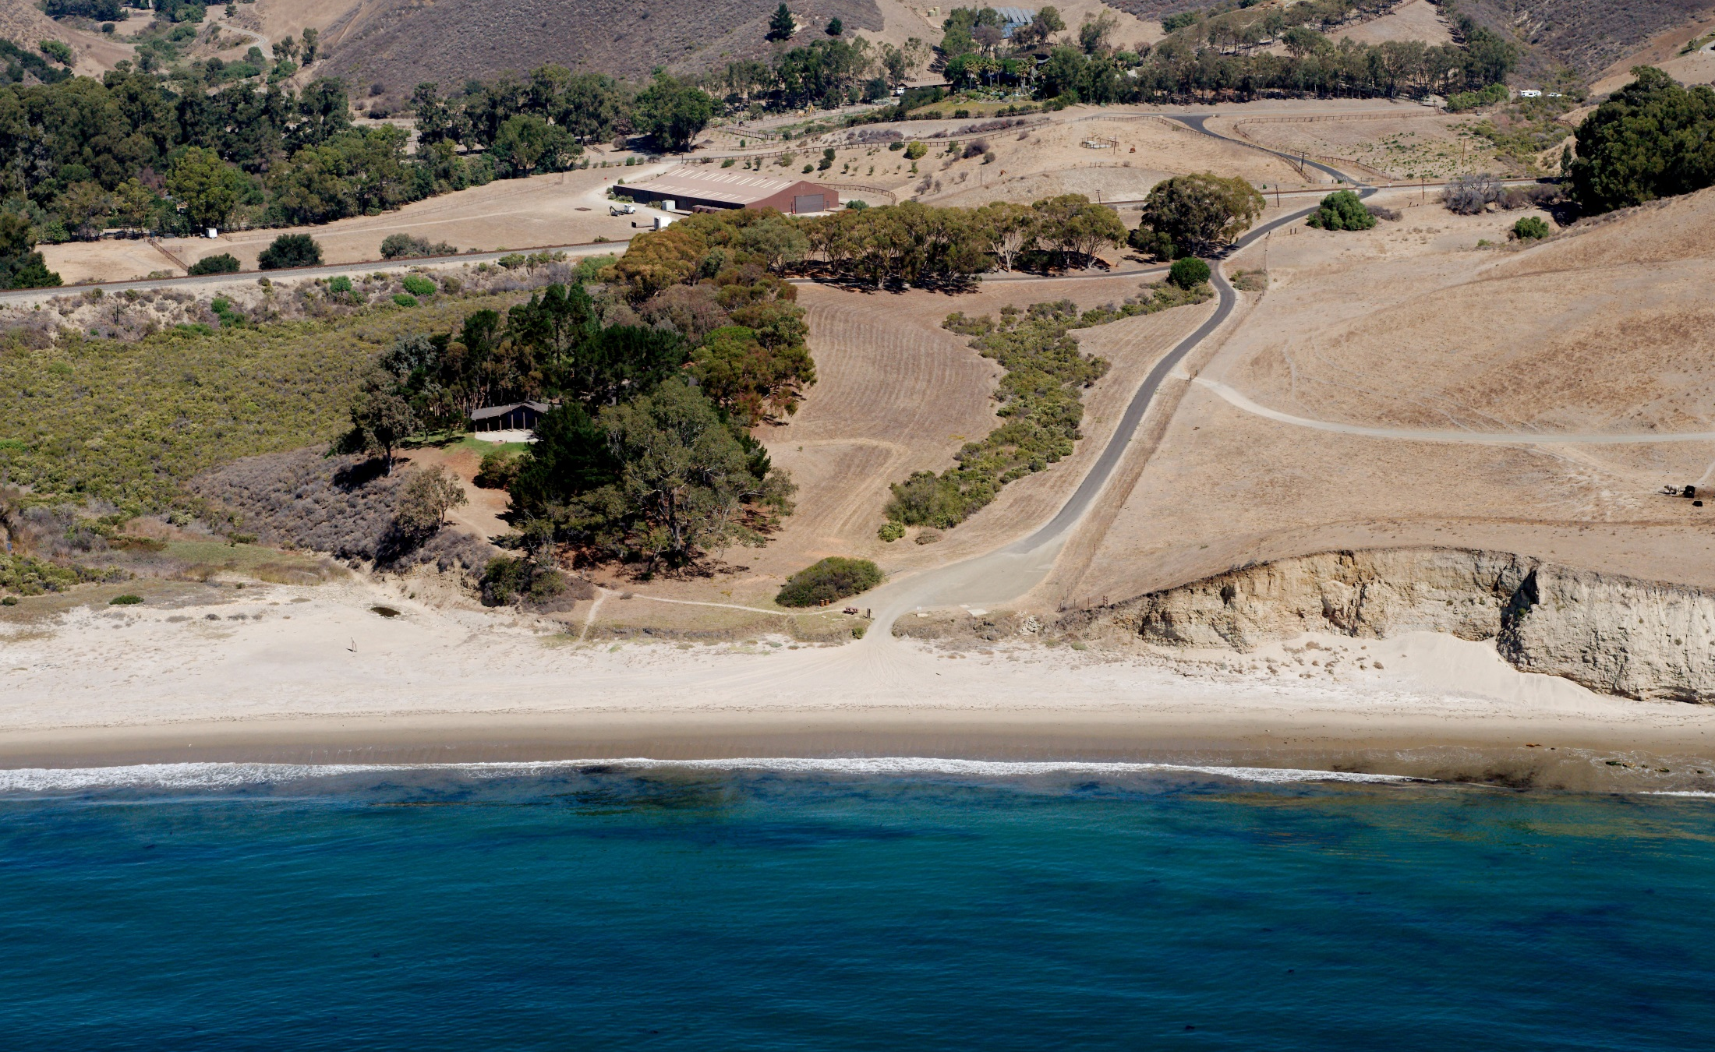
Copyright (C) 2002-2018 Kenneth & Gabrielle Adelman, California Coastal Records Project, www.Californiacoastline.org
Drakes Beach
CCRP # 201307681
California Coastal Commission
Statewide report– item F 5
Slide 24

Slide 25
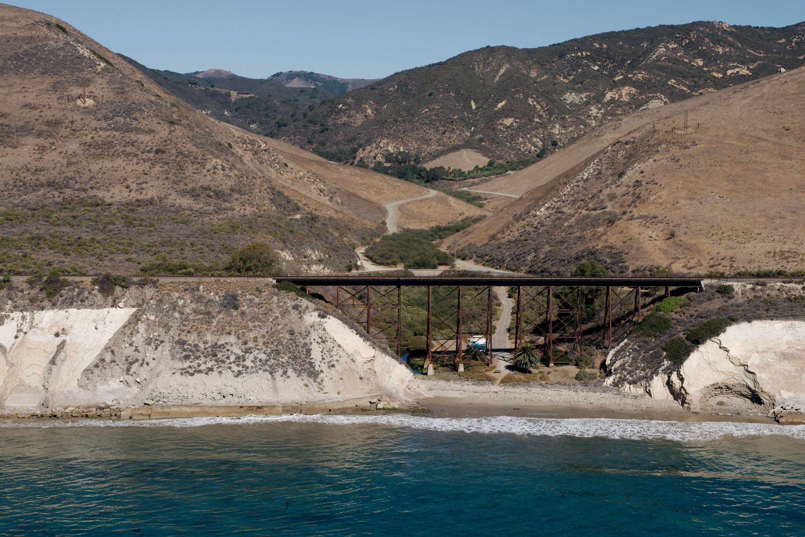
Agua Caliente Beach
CCRP# 201307735
California Coastal Commission
Statewide report– item F 5
Copyright (C) 2002-2018 Kenneth & Gabrielle Adelman, California Coastal Records Project, www.Californiacoastline.org
Slide 25

Slide 26
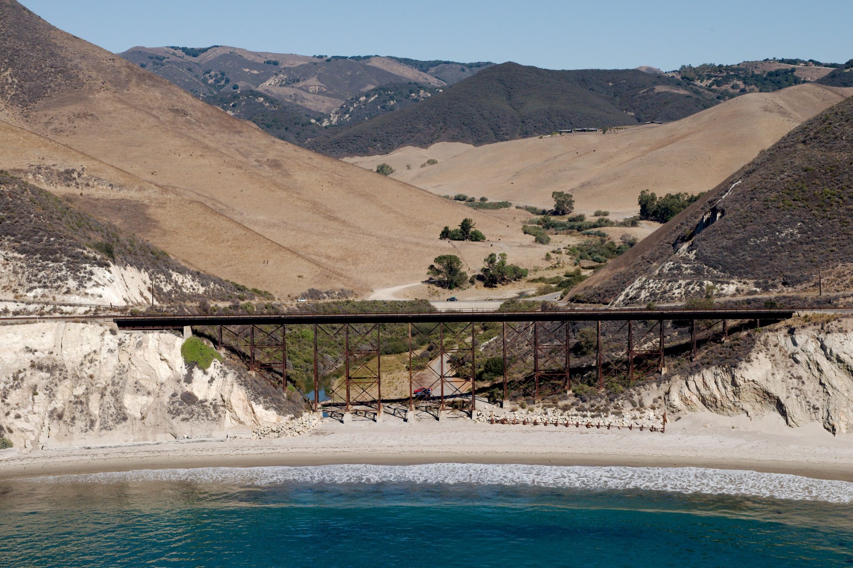
Copyright (C) 2002-2018 Kenneth & Gabrielle Adelman, California Coastal Records Project, www.Californiacoastline.org
Alegria Beach
CCRP # 201307715
California Coastal Commission
Statewide report– item F 5
Slide 26

Slide 27
Next steps
Public input and review
Local workshop
Inter-agency coordination
Evaluation of changed circumstances
Public review draft
Final adoption of revised plan
California Coastal Commission
Statewide report– item F 5
Slide 27

